Slide 1
Optum Rx – Enterprise Strategy – Roadmaps
October 31 2018
Confidential property of Optum. Do not distribute or reproduce without express permission from Optum.
Notes:
Marketing Owner: Julie Rosckes
Updated: December 2017
The traditional PBM model has been focused on driving down unit cost and distribution strategies vs. total health care value. OptumRx is changing this model by infusing transparency and visibility across the health system and creating the connections to impact total care and cost like never before to delivery better value.
It all starts with the data, analytics and expertise we have with OptumIQ and it fuels our differentiation, starting with:
Synchronizing clinical care: where we synchronize data, going beyond traditional PBMs, to look at all health and savings opportunities and connecting the member with the necessary resources to address the most pressing needs. Nowhere is this more important than in specialty, where 98% of the patients have multiple comorbidities.
We empower physicians by being the first to provide patient-specific benefit and cost information and the ability to clear a PA all within the physician’s EMR workflow in real-time vs. the guessing that leaves members without prescriptions or starting on a higher cost medication. Today through this capability, we are seeing more than 20% of all transactions with an alternative resulted in a drug change and more than 30% of prior authorizations were electronically initiated or avoided
We simplify the member experience by breaking down traditional silos and creating a connected, easier experience that pays attention to how a member wants to receive communications and looks at their entire health picture vs. just their prescriptions. For more complex specialty patients, we make live video consults available on demand for a better experience and improved adherence.
OptumRx focuses on impacting total cost, not just pharmacy cost. Pharmacy, as the most frequent health care touch point, creates an incredible opportunity to leverage real-time data to identify opportunities to impact overall cost and care. This starts with how we evaluate drugs for coverage and clinical programs to how we contract with drug manufacturers all the way to how we manage every member interaction. Through our unique combination of purchasing and operating scale, transparency and synchronized care, we drive as much as $200 dollars in savings per member, per year beyond traditional pharmacy management.

Slide 2







Optum partners across the health care system
Pharmacy care services
Population health management
MISSION: Helping people live healthier lives and helping make the health system work better for everyone
Data, analytics, expertise
Health care delivery
Health care operations
PROVIDERS
EMPLOYERS
HEALTH PLANS
LIFE SCIENCES
GOVERNMENTS
CONSUMERS
4/5
4/5
300
110
38
124
U.S. hospitals
of Fortune 100
health plans
organizations around the globe
states, DC and many federal entities
million empowered consumers
Confidential property of Optum. Do not distribute or reproduce without express permission from Optum.
Notes:
Marketing Owner: Julie Rosckes
Updated: January 2018
Our mission, which drives and inspires us every day, is to help people live healthier lives and help make the health system work better for everyone. It’s no accident that helping is in there twice.
Only Optum has the broad capabilities to tackle the biggest problems in health care. These capabilities touch virtually every facet of the health care delivery system. We support those who need care, those who provide care, those who pay for care and those who innovate for care. What this translates into for our clients is a deep knowledge of the way health care works and what needs to be done to make it work better.
The unique assets of Optum include care delivery, care delivery operations enablement, management of population health and pharmacy care services, enabling deep knowledge of the entire health care system. We truly understand the challenges faced by health care consumers and we understand what needs to be done to address these challenges head-on. At the heart of our offering is OptumIQ, combining curated data, leading analytics, and health care intelligence to create a comprehensive view of quality, cost and access at both an individual and population level. OptumIQ is infused in all our products and services. For OptumRx, it enables connections, fuels engagement and allows us to directly solve for some of the biggest challenges in health care.
We are clearing the path to a new model – one that leverages the power of Optum to transform the way we use the pharmacy benefit to impact cost and care.
________________________________________________________________
NOTE:
See Optum Value Story in the hub for more details. https://hub.uhg.com/sites/hub/Optum/Resources/Brand/Pages/BrandTools.aspx
See OptumIQ internal FAQ and other materials on the KIC.
https://optumkic.cipher-sys.com/OptumKIC/Search/KW/KWSearch?searchText=optumiq&isAttachment=true&isArchive=false&isFromNPS=False
Additional talking point considerations for further understanding in representing this slide:
Optum Capabilities:
OptumIQ example use cases for pharmacy include (but are not limited to):
How we make P&T management decisions using comprehensive curated data including real world evidence in modeling and outcome measurement.
Identifying the next best health and savings action a member should take to improve cost savings and health outcomes.
How we use predictive modeling in our Opioid Management program.
Pharmacy care services that go beyond the prescription to impact the overall health of members and bring new levels of value to pharmacy benefit sponsors.
Population health management, where all of our expertise, people and services come together to meet the unique needs of a population.
Health care delivery, where we are improving the overall patient and provider experience, driving value from the center of the system.
And Health care operations that help improve the overall performance of the health system.

Slide 3






Going beyond pharmacy to impact total care and cost
OptumRx foundation: Value and transparency
Traditional Focus
Synchronizing clinical care
Total health approach
Empowering physicians
Unprecedented visibility
Mail-driven
Data, analytics, expertise
Simplifying the member experience
Personalized and connected
Impacting total cost
Pharmacy and medical
Retail-driven
Confidential property of Optum. Do not distribute or reproduce without express permission from Optum.
Notes:
Marketing Owner: Julie Rosckes
Updated: December 2017
The traditional PBM model has been focused on driving down unit cost and distribution strategies vs. total health care value. OptumRx is changing this model by infusing transparency and visibility across the health system and creating the connections to impact total care and cost like never before to delivery better value.
It all starts with the data, analytics and expertise we have with OptumIQ and it fuels our differentiation, starting with:
Synchronizing clinical care: where we synchronize data, going beyond traditional PBMs, to look at all health and savings opportunities and connecting the member with the necessary resources to address the most pressing needs. Nowhere is this more important than in specialty, where 98% of the patients have multiple comorbidities.
We empower physicians by being the first to provide patient-specific benefit and cost information and the ability to clear a PA all within the physician’s EMR workflow in real-time vs. the guessing that leaves members without prescriptions or starting on a higher cost medication. Today through this capability, we are seeing more than 20% of all transactions with an alternative resulted in a drug change and more than 30% of prior authorizations were electronically initiated or avoided
We simplify the member experience by breaking down traditional silos and creating a connected, easier experience that pays attention to how a member wants to receive communications and looks at their entire health picture vs. just their prescriptions. For more complex specialty patients, we make live video consults available on demand for a better experience and improved adherence.
OptumRx focuses on impacting total cost, not just pharmacy cost. Pharmacy, as the most frequent health care touch point, creates an incredible opportunity to leverage real-time data to identify opportunities to impact overall cost and care. This starts with how we evaluate drugs for coverage and clinical programs to how we contract with drug manufacturers all the way to how we manage every member interaction. Through our unique combination of purchasing and operating scale, transparency and synchronized care, we drive as much as $200 dollars in savings per member, per year beyond traditional pharmacy management.
The next few slides go in to more detail on each of these areas where OptumRx really differentiates.

Slide 4
Optum Rx Integrated Planning Approach
Rx EA Strategy
Optum Tech Strategy
ORx LRP
Rx LOB Portfolios
ORx 2019 Tech Plan
Rx LOB
Integrated
Roadmaps

Slide 5
Optum Rx EA Strategy & Control Points Definition/approach
Architectural Strategy:
The application of strategic thinking with the aim of capturing economic value through architectural control.
Architectural Control Point
Is a system component that provides architectural control (enabling and constraining) over other system components and services.
Drive outcomes –
Stability
Scalability

Slide 6
Rx Enterprise Architecture Control Points Strategy and Enabler
Experience / Business Capabilities
Data – ML /AI
Create a personalized Customer Journey through a consistent user experience across all channels powered by end to end personalization
Strengthen our core Customer and Product Strategy by enabling a whenever-&-wherever data as a service platform. Powered by deep Machine Learning (ML) and Artificial Intelligence (AI) to provide a personalized customer experience
Strategy
Strategy
Consistency in presentation layer through a global UI platform to achieve differentiation and a disruptive approach in the healthcare user experience model
Independence from backend system unavailability and still be able to engage and fulfill customer needs through data enablement in middleware layer
Unified instrumentation and monitoring strategy from customer journey perspective across all OptumRx digital assets and channels
HCP adoption and promotion to enable the OptumRx customer eco-system
Data enablement which is channel specific and personalized
Streaming platform to abstract source data to a highly available and performant layer powered by enterprise caching technology
Provide data as a service at enterprise level which is formatted, relevant, feature friendly which can support localization and internationalization
Built in data governance and quality by design
Leverage next generation ML and AI technology to enrich experience and provide relevancy
Enabler
Enabler
Integration
Platform – SW Architecture & Technology
Build a Centralized Integration Service Layer for OptumRx that consolidates all business rules into a single platform. Built upon an Micro-services API platform that is resilient, highly-performant, scalable, agile and increases speed to market
Build highly available world class technology platform that is cloud enabled, resilient, scalable and can provide abstraction from backend system with optimization in cost and simplified stack
Strategy
Strategy
Consolidation of business logic empowered by micro-service API model
Achieve data canonicalization and re-usability through Edge, Coarse grained and Fine grained modeling of APIs
Containerization and cloud enablement readiness to support scale on demand at atomic entity level
Leverage API gateway to support service isolation and discovery. Enabled by robust security measures on authentication and rate-limiting
Cloud enabled SaaS model with autonomy on tool selection from a preferred list of Optum standard technologies /services
Active-active topology with built in CI/CD and support for blue/green deployment
Technology stack that can be auto-provisioned with least cost to maintain
Holistic instrumentation and monitoring across all eco-systems
Enabler
Enabler

Slide 7
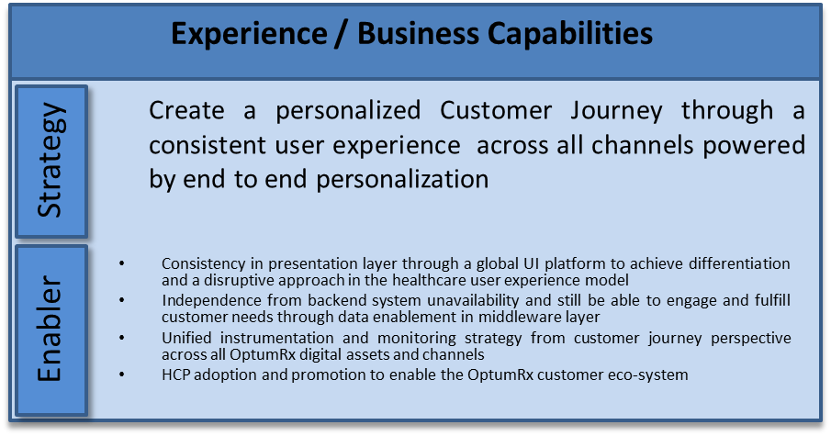

Rx Enterprise Architecture Control Points Experience Strategy Evolution Blueprint
Rx Enterprise Services Lifecycle
Evolving
Tactical Use
Enterprise Use
Goals
Decoupled Application Architecture (Micro Apps)
Cloud Native development strategy
Open Source content management system
Platform based UI strategy (Web & Mobile)
Canonicalization and widgets at feature level
Centralized Micro-service API strategy with single API gateway for all channels
Current - 2018
Future
Optum Data center
Public / Private Cloud
Portal 1
Portal 2
All Optum Rx Portals
All Mobile
Native
UI
Login
Global UI Platform
Locator
Presentation Layer
Refill
Benefits
Pref
HSID
Presentation Layer
CMS
Application Layer
Application Layer
Cabinet
Status
Pricing
Reminders
App-Config
HSID AEM
HSID AEM
Profile
Specialty
Authorization
Claims
Security
Instrumentation
Security
Logging Framework
Utilities Framework
Instrumentation
Security
Logging Framework
Instrumentation
Logging Framework
Caching Layer
Utilities Framework
Caching Layer
Utilities Framework
Micro-service API
RDBMS
RDBMS
Optum
HCP
hAPI
API
NoSQL DB

Slide 8
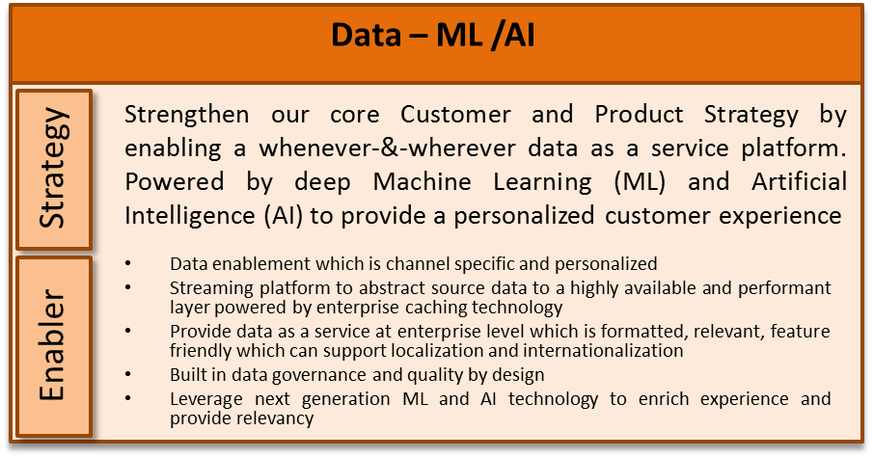



Rx Enterprise Architecture Control Points Data Strategy Evolution Blueprint
Rx Enterprise Services Lifecycle
Evolving
Tactical Use
Enterprise Use
Goals
Data-as-a-Service - decouple data from applications enabling richer services to clients and shifting data ownership to data stewardship philosophy.
Provide streaming capability to consolidated data ingestion, enrichment and consumption channels to enable business use and access without latency.
Provide reliable, query-able, SQL-friendly DataMarts to enable operational business needs using reporting facades. Expand advanced analytics and machine learning functionality.
Integration
API
Current -2018
Integration
Micro-Service API
Future
Data Governance
Data Stewardship
Metadata Management
Data Quality, Security
Data Governance
Data Stewardship
Metadata Management
Data Quality, Security
Data as a Service
Data Utilities/Functions
Data as a Service
Data Utilities/Functions
Analytics
Claims Consumer
Benefit Plans, CRM
Pharmacy
Lab, EMR
Data Syndication Tool
Analytics
Data Services
Data Services
Data
Data
ML/AI Workbench
Genomics
Pharmacy
Provider
Eligibility
Financial
Clinical
Behavior
ML/AI Workbench
Genomics
Pharmacy
Provider
Test Data Manager
Reporting
Test Data Manager
Reporting
Enterprise Streaming API
Optum Rx Local Data Stores (Direct)
Enterprise Streaming API
Optum Rx Data Stores
Streaming &Direct
Data Lake, Provider
PAS, IRIS, Rx Claim, NAV, Other
Medical/Rx Claims, Data Lake, Provider, Clinical, Eligibility
PAS, IRIS, Rx Claim,
NAV, Other

Slide 9
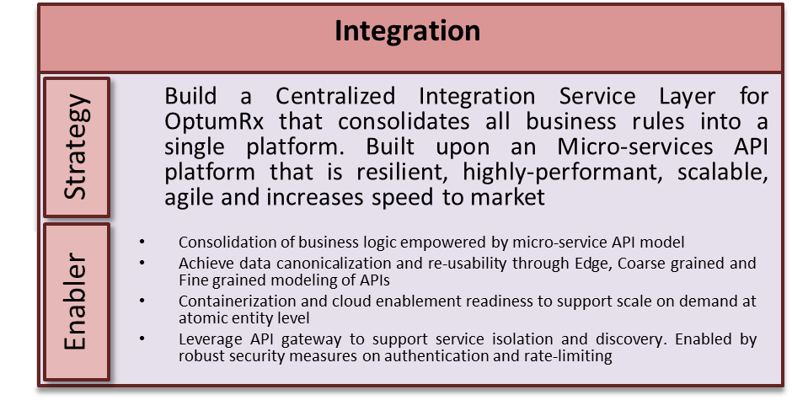

Rx Enterprise Architecture Control Points Integration Strategy Evolution Blueprint
Rx Enterprise Services Lifecycle
Goals
Evolving
Tactical Use
Enterprise Use
Micro-service API model
Channel specific tailored services via Edge API services
Centralization of business logic in one layer
Auto-provisioned CI/CD on cloud with elasticity, scalability and containerization
Global API gateway to provide service isolation
Future
Optum Data center
Public Cloud - Azure
Layer7
Stargate API Gateway
Rate-limit, Throttle, Authentication
Registry, Discovery, Rate-limit, Throttle, Isolation, Authentication, Authorization
Logging Framework
Instrumentation
Transformation, Aggregation, Orchestration
Security
asynchronous
EDGE API
synchronous
Asynchronous
Synchronous
EDGE API
Instrumentation
RxESB
ETL
Events
Coarse Grained Process API
Coarse Grained Process API
Logging
Transformation
Aggregation
Orchestration
Data Service Layer
Reporting
Queues
Fine Grained Micro-Service
Fine Grained Micro-Service
Fine Grained Micro-Service

Slide 10
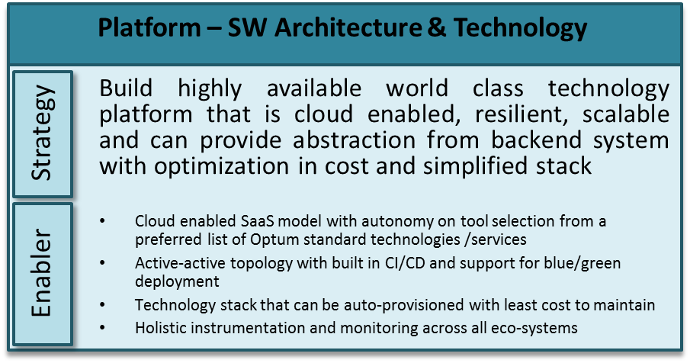



Rx Enterprise Architecture Control Points Platform Strategy Evolution Blueprint
Rx Enterprise Services Lifecycle
Goals
Evolving
Tactical Use
Enterprise Use
Cloud first strategy
On-demand self service provisioning and management
Auto provisioning and scaling
Built in resiliency and availability patterns
Resource pooling (enables multi-tenancy and efficient use of computing resources)
Built in security and management framework
Built in instrumentation, monitoring and reporting
Integration
Integration
Optum Rx Enterprise Service Bus
Optum Rx Enterprise Service Bus
Data
Data
Optum Rx Enterprise Data Services
Optum Rx Enterprise Data Services
Auto Provision
Instrumentation
Containerization
Auto Provision
Instrumentation
Containerization
Auto Scaling
Security Framework
Auto Scaling
Blue / Green Deploy
Security Framework
Platform
Platform Utilities
Platform
Platform Utilities
Web/
Pres
Apache, AEM
Capacity Mgmt
Apache, IIS, IHS, AEM
Web/
Pres
Apache, IIS, AEM
Capacity Mgmt
IIS
CI/CD
CI/CD
Production Services
jBoss, Tomcat
Authentication
jBoss, WAS, MF, Tomcat, WebLogic
Production Services
Authentication
jBoss, WAS,
WebLogic
App
App
jBoss, Tomcat, NodeJS
Reporting
Reporting
mySql
Env Mgmt
DB2, Oracle, mySQL, SQL, Netezza, Sybase
Env Mgmt
DB2, Oracle, SQL, Netezza, Sybase
DB
Perf Test
DB
mySql, SQL, NoSQL
Perf Test
Public / Private Cloud
Certs Mgmt
Dedicated / Virtual Hosting
Public / Private Cloud
Certs Mgmt
Dedicated / Virtual Hosting
OSFI
Azure
AWS
ELR
CTC
OSFI
Azure
AWS
ELR
CTC

Slide 11
Optum Rx Integration Services
Middleware and ESB

Slide 12
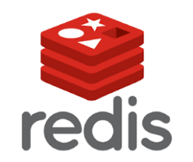

OptumRx Future State Middleware Layer – Evolution to Future State
Current - 2018
Targeted Focus in Transformation Journey
Future
Layer7
Migrate from Layer7 to Stargate as an Enterprise API Gateway which can support Service Registry, Throttling, Discovery, Rate-Limiting, Authentication and Authorization
Stargate API Gateway
Rate-limit, Throttle, Authentication
Registry, Discovery, Rate-limit, Throttle, Authentication, Authorization
Transformation, Aggregation, Orchestration
Unified ESB strategy in terms of technology stack
Consolidation of API business logic in the new Middleware layer
Micro-service API model
Integration of NFR around Logging, Instrumentation, Security and Utilities into a common framework
asynchronous
EDGE API
synchronous
Asynchronous
Synchronous
EDGE API
Instrumentation
RxESB
ETL
Events
Logging
Transformation
Coarse Grained Process API
Coarse Grained Process API
Aggregation
Orchestration
Reporting
Queues
Fine Grained Micro-Service
Fine Grained Micro-Service
Fine Grained Micro-Service
Logging Framework
Instrumentation
Data Service Layer
Security
Layer7
NoSQL Data persistence model for maximum performance
Centralized Enterprise Caching
Source Insulation from backend systems and data enablement through real-time data streaming platform
Materialized Views
Materialized Views
Materialized Views
Materialized Views
Materialized Views
External Data
Optum Provider Data
DRx
Exact Target
Trust Commerce
EPMP
ScriptMed
RxClaim
RxAdmin
RxWeb
IRIS
RxCCR
PAS
Data Transformation Layer
Consumer
Topic
Topic
Topic
Topic
Topic
Topic
Topic
Topic
Topic
Topic
Topic
Publisher

Slide 13

Platform: Enterprise Common Services Rx LOB: DSG Rx Owner: SK
Optum Rx Enterprise Roadmap
Completed
Proposed
Agreed Upon
Domain |  | 2018 | 2019 |  |  |  | 2020 |  | 2021
 |  | Q4 Current | Q1 | Q2 | Q3 | Q4 | 1H | 2H
API Topology & Hosting Environment |  | SOAP & REST APIs hosted in uCI | IRIS Specialty transformation API to Micro-service model REST APIs (new development) in OSFI | IRIS DSG Portal API to Micro-service model RxClaim migration REST APIs (new development) in OSFI | NAV API to Micro-service model REST APIs (new development) in OSFI | PAS API to Micro-service model REST APIs (new development) in OSFI
API Gateway |  | Layer7 Build federated StarGate environments | Migrate from Layer7 to StarGate | StarGate | StarGate | StarGate | StarGate | StarGate | StarGate
APP Technology |  | Java/J2EE and Cloud SDK, Spring Monolithic branching strategy Transform branching strategy from monolithic to micro-service deployment strategy | Java/J2EE and Cloud SDK, Spring Transform branching strategy from monolithic to micro-service deployment strategy | JAVA/J2EE/Cloud SDK/Spring Micro-service branching strategy | JAVA/J2EE/Cloud SDK/Spring Micro-service branching strategy | JAVA/J2EE/Cloud SDK/Spring Micro-service branching strategy | JAVA/J2EE/Cloud SDK/Spring Micro-service branching strategy | JAVA/J2EE/Cloud SDK/Spring Micro-service branching strategy | JAVA/J2EE/Cloud SDK/Spring Micro-service branching strategy
ESB | Async |  | Migrate from TIBCO to Kafka Streaming for Async needs for ETL, Batch and Reporting | Migrate from TIBCO to Kafka Streaming for Async needs continued…
 | Synch |  | Micro-service API for Specialty | Micro-service API for IRIS DSG | Micro-service API for NAV
DB Platform & Caching |  | Oracle – Upgrade MySql No-Caching Capabilities | Cassandra NoSQL DB Cache sourced experience for Specialty | Cassandra NoSQL DB Cache sourced experience for IRIS DSG | Cassandra NoSQL DB Cache sourced experience for NAV
Data Streaming |  | Kafka POC Enablement | Specialty data enablement through Kafka to Middleware Layer | IRIS data enablement through Kafka to Middleware Layer | Nav data enablement through Kafka to Middleware Layer
HA/DR |  | Active – Active (RTO 8, RPO 0) DB – Active/Standby (RTO 8, RPO 1)
Capital Outlook
Native Business Capability
L0: Manage Operations
L1: Data Operations
L2: Data Strategy
L3: Data Integration Strategy
L0: Informational Technology Management
L1: Information Technology Enabling Services
L2: Data Operations (C)
L3: Data Integration
L1: Define & Govern IT Strategy
L2: Technology & Infrastructure Strategy
L3: Application & Infrastructure Hosting
System Dependencies
L0: Administer Benefits & Services
RxCLAIM, PAS, RxCCR, RxWeb, Formulary Management, RTA, RxBuilder, Zynchros
L0: Manage Health Services
IRIS, PAS, ScriptMed, CBS
L0: Manage Operations
IRIS, Backend Dispensing
L0: Constituent Service Experience
IRIS
L0: Product
RxAdmin
Application / Platform TCO
2018:$3,042K
2019:
2020:
Notes: As of August 2018:
$2,043K (Infrastructure)
$1,227K OptumRx API ESB Tibco
$435K OptumRx Data API Custom
$70K Data API REST
$308K OptumRx Data API SOAP
$3K RxESB Cache
$999K (O&M)
$853K ORx - Web Services/ECS (Catamaran)
$146K ORx WebServices

Slide 14
Optum Rx Digital Services Group
Portals and Mobile Platforms

Slide 15













ORx Architecture – DSG Enterprise – Evolution to Future State
Current - 2018
Intermediate – 2019 (Q2)
Future – 2019 (Q3-Q4)
IBM Mobile
Portal
Portal
Portal
IBM MobileFirst
F5→Layer7→hAPI
F5→Stargate API Gateway
Asynchronous
Synchronous
Asynchronous
Synchronous
RxESB
ETL
Reporting
Events
Queues
Transformation
EDGE API
Orchestration
Aggregation
Coarse Grained Process API
Data Service Layer
Fine Grained Micro-Service
Materialized View - Portal
Materialized View - Mobile
hAPI
Data Transformation
Data Transformation
Topic
Topic
Topic
Topic
Topic
Topic
Topic
Topic
Topic
Topic
Topic
Topic
Topic
Topic
Topic
Topic
Topic
Topic
Asynchronous
Synchronous
Topic
Topic
Topic
Topic
IRIS SOA Service
RxESB
Data Service Layer
Data Modeling Layer
Data Modeling Layer
Backend Systems
CDC/Attinuity
CDC/Attinuity
Backend Systems
Backend Systems

Slide 16

ORx DSG Member Portal – Evolution to Future State
Current - 2018
Targeted Focus in Transformation Journey
Future
Member
Member
Layer7
Layer7
Presentation Layer
Migrate from Adobe Experience Manager to Open source Content Management System
Presentation Layer
Open Source
CMS
HSID
Application Layer
HSID AEM
Application Layer
Utilities
Security
Instrumentation
Stargate API Gateway
Logging Framework
Utilities Framework
Migrate to Stargate API Gateway
Consolidation of API business logic in the new Middleware layer
Micro-service API model
Integration of NFR around Logging, Instrumentation, Security and Utilities into a common framework
Caching Layer
Asynchronous
Synchronous
Instrumentation
Logging Framework
Security
hAPI
Oracle
ETL
Reporting
Events
Queues
EDGE API
Transformation
Orchestration
Aggregation
Coarse Grained Process API
Fine Grained Micro-Service
Asynchronous
Synchronous
RxESB
IRIS OSB
NoSQL Data persistence model for maximum performance
Centralized Enterprise Caching
Materialized View - Portal
Materialized View - Mobile
Data Service Layer
Source Insulation from backend systems and data enablement through real-time data streaming platform
External Data
Optum Provider Data
Streaming Platform
DRx
Exact Target
Trust Commerce
EPMP
ScriptMed
RxClaim
RxAdmin
RxWeb
RxCCR
PAS
Optum Provider Data
External Data
DRx
Exact Target
Trust Commerce
EPMP
ScriptMed
RxClaim
RxAdmin
RxWeb
IRIS
RxCCR
PAS

Slide 17
Application: Member Portal Rx LOB: DSG Rx Owner: SK
Optum Rx Enterprise Roadmap
Proposed
Agreed Upon
Completed
Domain |  | 2018 | 2019 |  |  |  | 2020 |  | 2021
 |  | Q4 Current | Q1 | Q2 | Q3 | Q4 | 1H | 2H
HCP Features |  | (5) Prior Auth Text Messages ACH, Formulary API (3) Global Activation & Initial Load of ORx programs (3) EPMP Digital fulfillment Patt D Book A EOBs (1) Household access w/CAG (1) UHC Rally Choice OE (1) EPMP RxPortal comm pref link exclusion list (2) Edit days supply to 365, 12 months contraceptive (6) Willis Towers Watson/ADM, Clear Channel Outdoor Inc, Prudential, Eaton Corp, Peace HealthQuantum, US LDM LLC , Quantum Health (1) Pharmacy Locator Dispenser Type/Class Alterations Misc (5) – Offer Management and Technical features | All Member Portal Q1 2019 Roadmap features will be finalized on 11/13/18 | All Member Portal Q2 2019 Roadmap features will be finalized on 11/13/18 Draft Information – TBD Release automation and optimization Drug pricing - Specialty Medications | All Member Portal Q3 2019 Roadmap features will be finalized on 11/13/18 Draft Information – TBD UHC Multi-Product- Navigation, Global Header, Cart, Content search Deconstruct CHP Module | All Member Portal Q4 2019 Roadmap features will be finalized on 11/13/18 Draft Information – TBD Improved Technical set-up process for site De-couple RxAuth/PAS related calls from backend system and enable data in the middleware layer | All Member Portal Q1 2020 Roadmap features will be finalized on 11/13/18 Draft Information – TBD De-couple RxClaim related calls from backend system and enable data in the middleware layer
App Code Base |  | Java AEM Angular |  |  |  |  |  | Open Source CMS
Web App | VM | Prod Stage
 | Cloud | Test QA1 – OSE QA2 – OSE QA3 – OSE DEMO - OSE Dev – OSO |  | Test – OSO Migration |  | Prod -OSO Stage – OSO
DB Platform |  | Oracle – Upgrade MySql |  |  |  | Migrate Oracle data to Cassandra
Integration |  | HAPI ECS (RxESB) AE/UPM RxWeb TIBCO ISL Google API | Consolidate HAPI and ECS for Specialty transformation into the micro-service API middleware layer |  | Consolidate HAPI and ECS for IRIS related calls into the micro-service API middleware layer | Consolidate HAPI and ECS for RxAuth/PAS related calls into the micro-service API middleware layer | Consolidate HAPI and ECS for RxClaim related calls into the micro-service API middleware layer
HA/DR |  | Active – Active (RTO 8, RPO 0) DB – Active/Standby (RTO 8, RPO 1)
Capital Outlook |  | TBD Decom of Legacy Member Portal
Native Business Capability
L0: Manage Operations
L1: Contact Operations
L2 Service Operations
L3 Claim Status
L1: Inventory, Orders, Logistics & Fulfillment
L2 Orders
L3 Order Capture
L3 Tracking
L0: Manage Health Services
L1: Care Delivery
L2 Prescription Management
L3 Prescription Intake
L1: Health Decision Support
L2 Health Education
L2 Provider Selection
L2 Treatment Selection
L3 Healthcare Cost Estimation
L1: Utilization Management
L2 Clinical Coverage Review
L3 Coverage Determination
L0: Manage Demand
L1: Perform Marketing
L2Develop & execute Campaigns
L0: Constituent Service Experience
L1: Consumer Decision Support
L2 Enable Consumer Health Care Ownership
L2 Enable Provider Selection
L1: Constituent Services Preferences
L2 Manage Preferences
L1: Consumer Engagement
L2 Manage Consumer Communications
L3 Maintain Contact history
System Dependencies
L1: Utilization Management
RxAuth/Prior Authorization System
L1: Inventory, Orders, Logistics & Fulfillment
IRIS
L1: Financial Services
UHG Payment Gateway
L1: Data Operations
ESB/DSG-hAPI
L1: Manage Claims
RxClaim
L1: Provider Demographic Management
Optum Insight P360
L1: Health Decision Support
RxWeb , iNet DB, Google API, DestinationRx, Goldstandard
L1: Information Technology Enabling Services
Documentum, Conduent API
Application / Platform TCO
2018: as of Aug 2018: $3,742K
2019:
2020:
Notes: As of August 2018:
$663K (Infrastructure)
$3,079K (O&M) - Numbers include figures for “ORx - RxPortal”/ “Consumer Portal (OptumRx)”/” OptumRx Member Portal” billing applications
Consumer Portal (OptumRx) $1,040K
OptumRx Member Portal $335K
ORx – RxPortal $1,704K

Slide 18


BriovaRx Patient Portal – Evolution to Future State
Member
Targeted Focus in Transformation Journey
Member
Layer7
Layer7
Migrate from Adobe Experience Manager to Open source Content Management System
Presentation Layer
Open Source
CMS
Presentation Layer
HSID
Application Layer
HSID AEM
Utilities
Security
Migrate to Stargate API Gateway
Consolidation of API business logic in the new Middleware layer
Micro-service API model
Integration of NFR around Logging, Instrumentation, Security and Utilities into a common framework
Stargate API Gateway
Instrumentation
Logging Framework
Utilities Framework
Application Layer
Asynchronous
Synchronous
Instrumentation
Logging Framework
Security
Oracle
ETL
Reporting
Events
Queues
Transformation
EDGE API
Orchestration
Aggregation
Coarse Grained Process API
Fine Grained Micro-Service
Asynchronous
Synchronous
NoSQL Data persistence model for maximum performance
Centralized Enterprise Caching,
All new RxESB service layer
Materialized View - Portal
Materialized View - Mobile
External API
Image
Queue
Data Service Layer
Streaming Platform
External Data
External Provider Data
Specialty Transformation entails migration from ScriptMed to IRIS,
with all new (20) RxESB Edge
and Course Grained APIs for
BriovaRx Portal, BriovaRx Mobile
External Data
Optum Provider Data
BriovaRx Exchange
Creehan WS
Exact Target
Qualtrics
OpenTok
UPG
DRx
Exact Target
Trust Commerce
EPMP
RxWeb
RxClaim
RxAdmin
IRIS
RxCCR
PAS
Script
Med

Slide 19
Application: BriovaRx Patient Portal/ Public Site Rx LOB: DSG Rx Owner: SK
Optum Rx Enterprise Roadmap
Completed
Proposed
Agreed Upon
Domain |  | 2018 | 2019 |  |  |  | 2020 |  | 2021
 |  | Q4 Current | Q1 | Q2 | Q3 | Q4 | 1H | 2H
HCP Features |  |  |  | Specialty Transformation MVP
App Code Base |  | Java Angular |  |  |  | Angular Micro Services
Web App | VM | Prod Stage Test Dev – Migrate to CTC | Prod – Migrate to ELR Stage – Migrate to ELR Test – Migrate to CTC
 | Cloud |  |  |  |  | Dev to OSO
DB Platform |  | Oracle – Migrate Dev to CTC | Oracle – Migrate Test, Stage, & Prod to MN DC |  |  |  | Migrate Oracle data to Cassandra
Integration |  | TIBCO ScriptMed POC RxESB to IRIS OpenTok UHG Pmt Gateway RxESB to CRM (Salesforce) | RxESB to IRIS (Partial) | Off of ScriptMed TIBCO to RxESB Conversion |  | Migrate RxAuth/PAS related service calls to RxESB Migrate SalesForce API calls to RxESB
HA/DR |  | HA in EGV no DR DB – Active/Standby (Best effort) | Prod, Stage, & Test setup in MN DC | Active/Active (RTO 8, RPO 0) DB – Active/Standby (RTO 8, RPO 1)
Capital Outlook |  | TBD
Native Business Capability
L0: Manage Operations
L1: Inventory, Orders, Logistics & Fulfillment
L2 Orders
L3 Order Capture
L3 Tracking
L3 Intake Order Payment
L0: Manage Health Services
L1: Care Delivery
L2 Patient Encounter
L3 Patient Communication & Engagement
L3 Delivery Venue
L3 Patient Education
L3 Ancillary Services Ordering
L3 Patient Evaluations & Treatment
L1: Health Decision Support
L2 Health Education
L2 Provider Selection
L2 Treatment Selection
L3 Health Care Cost Estimation
L0: Manage Demand
L1: Perform Marketing
L2 Create Marketing Strategy
L2 Develop & Execute Campaigns
System Dependencies
L1: Inventory, Orders, Logistics & Fulfillment
ScriptMed
L1: Data Operations
ESB
L1: Financial Services
UHG Payment Gateway
L1: Information Technology Enabling Services
HSID
Application / Platform TCO
2018: $5K – see notes.
2019:
2020:
Notes: As of Aug 2018:
$78 (Infrastructure) – Charges available only for month of August.
$5K (O&M) – Charges available only for months of Jan. and Feb. after which they drop off. Unable to locate any additional O&M charges.
Under review

Slide 20

BriovaRx Provider Portal – Evolution to Future State
Provider
Provider
Targeted Focus in Transformation Journey
Layer7
Layer7
Presentation Layer
Presentation Layer
OPTUM ID
Application Layer
Optum ID
Utilities
Security
Migrate to Stargate API Gateway
Consolidation of API business logic in the new Middleware layer
Micro-service API model
Integration of NFR around Logging, Instrumentation, Security and Utilities into a common framework
Stargate API Gateway
Instrumentation
Logging Framework
Utilities Framework
Application Layer
Asynchronous
Synchronous
Instrumentation
Logging Framework
Security
Oracle
ETL
Reporting
Events
Queues
Transformation
EDGE API
Orchestration
Aggregation
Coarse Grained Process API
Fine Grained Micro-Service
Asynchronous
Synchronous
NoSQL Data persistence model for maximum performance
Centralized Enterprise Caching,
All new RxESB service layer
Materialized View - Portal
Materialized View - Mobile
External API
Data Service Layer
Streaming Platform
External Data
External Provider Data
Specialty Transformation entails migration from ScriptMed to IRIS,
with all new RxESB Edge
and Course Grained APIs for
BriovaRx Provider Portal integration w/IRIS,, Briova Rx Exchange Salesforce , PAS
External Data
Optum Provider Data
BriovaRx Exchange
Creehan WS
BriovaRx Exchange
IRIS
PAS
PAS
Script
Med

Slide 21
Application: BriovaRx Provider Portal Rx LOB: DSG Rx Owner: SK
Optum Rx Enterprise Roadmap
Completed
Proposed
Agreed Upon
Domain |  | 2018 | 2019 |  |  |  | 2020 |  | 2021
 |  | Q4 Current | Q1 | Q2 | Q3 | Q4 | 1H | 2H
HCP Features |  | Connection to Briova Exchange CRM | Specialty Transformation Integration with ECS APIs UI Development | Specialty Transformation MVP
App Code Base |  | Java Angular Development of services for connection to Briova Exchange
Web App | VM | Prod Stage Test Dev – Migrate to CTC | Prod – Migrate to ELR Stage – Migrate to ELR Test – Migrate to CTC
 | Cloud |  |  |  |  | Dev to OSO
DB Platform |  | Oracle – Migrate Dev to CTC | Oracle – Migrate Test, Stage, & Prod to MN DC |  |  |  | Migrate Oracle data to Cassandra
Integration |  | TIBCO ScriptMed POC RxESB to IRIS RxESB to CRM Briova Exchange | RxESB to IRIS (Partial) | Off of ScriptMed TIBCO to RxESB Conversion
HA/DR |  | HA in EGV no DR DB – Active/Standby (Best effort) | Prod, Stage, & Test setup in MN DC | Active/Active (RTO 8, RPO 0) DB – Active/Standby (RTO 8, RPO 1)
Capital Outlook |  | TBD
Native Business Capability
L0: Manage Health Services
L1: Care Delivery
L2: Prescription Management
L1: Health Decision Support
L2: Medication Management
L1: Health & Care Management
L2: Care Coordination
L2: Complex Case Management
L0: Manage Providers
L1: Provider Relationship Management
L2 Provider Data Service & Issue Resolution
System Dependencies
L1: Utilization Management
PAS
L1: Information Technology Enabling Services
Optum ID
L1: Manage Claims
ScriptMed
L1: Information Technology Enabling Services
Optum ID
L1: Provider Networks Analytics & Reporting
Briova Exchange
L1: Health & Care Management
IRIS
Application / Platform TCO
2018: $45K – see notes.
2019:
2020:
Notes: Notes: As of Aug 2018:
$45k (Infrastructure)
Unable to locate O&M costs.
Under review

Slide 22
ORx DSG Mobile – Evolution to Future State
Current - 2018
Targeted Focus in Transformation Journey
Future
Member
Member
Layer7
Layer7
Presentation Layer
Migrate from Adobe Experience Manager to Open source Content Management System
Presentation Layer
Open Source
CMS
HSID
Application Layer
HSID AEM
Application Layer
Utilities
Security
Instrumentation
Stargate API Gateway
Logging Framework
Utilities Framework
Migrate to Stargate API Gateway
Consolidation of API business logic in the new Middleware layer
Micro-service API model
Integration of NFR around Logging, Instrumentation, Security and Utilities into a common framework
Caching Layer
Asynchronous
Synchronous
Instrumentation
Logging Framework
Security
hAPI
Oracle
ETL
Reporting
Events
Queues
EDGE API
Transformation
Orchestration
Aggregation
Coarse Grained Process API
Fine Grained Micro-Service
Asynchronous
Synchronous
RxESB
IRIS OSB
NoSQL Data persistence model for maximum performance
Centralized Enterprise Caching
Materialized View - Portal
Materialized View - Mobile
Data Service Layer
Source Insulation from backend systems and data enablement through real-time data streaming platform
External Data
Optum Provider Data
Streaming Platform
DRx
Exact Target
Trust Commerce
EPMP
ScriptMed
RxClaim
RxAdmin
RxWeb
RxCCR
PAS
Optum Provider Data
External Data
DRx
Exact Target
Trust Commerce
EPMP
ScriptMed
RxClaim
RxAdmin
RxWeb
IRIS
RxCCR
PAS

Slide 23
Application: Member Mobile Rx LOB: DSG Rx Owner: SK
Optum Rx Enterprise Roadmap
Completed
Proposed
Agreed Upon
Domain |  | 2018 | 2019 |  |  |  | 2020 |  | 2021
 |  | Q4 Current | Q1 | Q2 | Q3 | Q4 | 1H | 2H
HCP Features |  | ESP Phase !! ACH OptumRx Chat Push Notifications Meds Checkout Attention External Demand Accessibility Add Credit Card by Photo IRIS Decoupling | BPE | Maintenance Mode for Current App Ongoing Development and platform migration for New Native App | Maintenance Mode for Current App Ongoing Development and platform migration for New Native App
App Code Base |  | JavaScript IBM Mobile Foundation SDK jQuery HSID pages | Tealeaf Analytics Observe Point /AEM Tagging |  | Start migration to Native app
Web App | VM | Prod Stage Test – build new for V8 Dev – build new for V8 V8 Production
 | Cloud |  |  |  |  | Dev - OSO POC
DB Platform |  | Oracle - Upgrade
Integration |  | HAPI Google API RxESB Migration – API Gateway, Edge, Course grained, & microservices |  |  | Consolidate HAPI and ECS for IRIS related calls into the micro-service API middleware layer |  | Consolidate HAPI and ECS for RxClaim related calls into the micro-service API middleware layer
HA/DR |  | Active – Active (RTO 8, RPO 0) DB – Active/Standby (RTO 8, RPO 1)
Capital Outlook
Native Business Capability
L0: Manage Operations
L1: Contact Operations
L2 Service Operations
L3 Claim Status
L1: Inventory, Orders, Logistics & Fulfillment
L2 Orders
L3 Order Capture
L3 Tracking
L0: Manage Health Services
L1: Care Delivery
L2 Prescription Management
L3 Prescription Intake
L1: Health Decision Support
L2 Health Education
L2 Treatment Selection
L3 Healthcare Cost Estimation
L1: Utilization Management
L2 Clinical Coverage Review
L3 Coverage Determination
L0: Constituent Service Experience
L1: Consumer Decision Support
L2 Enable Consumer Health Care Ownership
L2 Enable Provider Selection
System Dependencies
L1: Utilization Management
RxAuth/Prior Authorization System
L1: Inventory, Orders, Logistics & Fulfillment
IRIS
L1: Financial Services
UHG Payment Gateway
L1: Data Operations
ESB/DSG-hAPI
L1: Manage Claims
RxClaim
L1: Health Decision Support
RxWeb, iNet DB, Google API, DestinationRx, Goldstandard
Application / Platform TCO
2018: $879K
2019:
2020:
Notes: As of August 2018:
$559K (Infrastructure)
$320K (O&M) – Numbers include figures for OptumRx Member Mobile/ OptumRx Mobile billing applications

Slide 24



BriovaRx Mobile – Evolution to Future State
Member
Targeted Focus in Transformation Journey
Member
Layer7
Native UI
Migrate from Adobe Experience Manager to Open source Content Management System
Layer7
Presentation Layer
HSID AEM
Stargate API Gateway
iChat
Security
Migrate to Stargate API Gateway
Consolidation of API business logic in the new Middleware layer
Micro-service API model
Integration of NFR around Logging, Instrumentation, Security and Utilities into a common framework
Utilities
Instrumentation
Logging Framework
Utilities Framework
HSID
Application Layer
Asynchronous
Synchronous
Oracle
ETL
Reporting
Events
Queues
EDGE API
Logging Framework
Instrumentation
Security
Transformation
Orchestration
Aggregation
Coarse Grained Process API
Asynchronous
Fine Grained Micro-Service
Synchronous
NoSQL Data persistence model for maximum performance
Centralized Enterprise Caching,
All new RxESB service layer
External API
Image
Queue
Materialized View - Portal
Materialized View - Mobile
Data Service Layer
External Data
External Provider Data
Specialty Transformation entails migration from ScriptMed to IRIS,
with all new (20) RxESB Edge
And Course Grained APIs for
BriovaRx Portal, BriovaRx Mobile
Streaming Platform
BriovaRx Exchange
Creehan WS
Exact Target
Qualtrics
OpenTok
UPG
Script
Med
External Data
Optum Provider Data
DRx
Trust
Commerce
EPMP
RxClaim
IRIS
Exact Target

Slide 25
Application: BriovaRx Mobile Rx LOB: DSG Rx Owner: SK
Optum Rx Enterprise Roadmap
Completed
Proposed
Agreed Upon
Domain |  | 2018 | 2019 |  |  |  | 2020 |  | 2021
 |  | Q4 Current | Q1 | Q2 | Q3 | Q4 | 1H | 2H
HCP Features |  | Specialty Transformation Native App Development | Specialty Transformation Native App EDGI API Integration Development | Specialty Transformation MVP
App Code Base |  | Java AEM
Web App | VM | Prod Stage Test Dev
 | Cloud |  |  | Stage Test Dev | Production
DB Platform |  | iSeries
Integration |  | SXC Web Services
HA/DR |  | Active/Standby (RTO 8, RPO 0)
Capital Outlook |  | TBD
Native Business Capability
L0: Manage Operations
L1: Inventory, Orders, Logistics & Fulfillment
L2 Orders
L3 Intake Order Payment
L0: Manage Health Services
L1: Health Decision Support
L2 Health Education
L2 Clinical Coverage Review
L3 Coverage Determination
L0: Manage Providers
L1: Provider Relationship Management
L2 Provider Communication & Training
System Dependencies
L1: Inventory, Orders, Logistics & Fulfillment
ScriptMed→ moving to → IRIS
L1: Financial Services
UHG Payment Gateway
L1: Data Operations
RxESB
L1: Information Technology Enabling Services
HSID
Application / Platform TCO
2018: see notes
2019:
2020:
Notes: As of August 2018:
There do not seem to be any numbers available for this asset on the O&M or Infrastructure bills.
Under review

Slide 26
EA Governance: ORx EA/OSAM Value Stream Activities and Deliverables
EPMO
Planning
Program Delivery Support
Strategy & Planning
Program Support
Architectural Design Review/Scoring
PI Planning
Sprint Delivery
Production Support (SS&MO)
PESC Arch Review
Roadmap Definition
Early Identification of ORx Architecture Impacts
Define High-Level
Architecture
Optum ARB
OptumTech Council
Scope Definition
Solution Outline
Solution Integration Document
= Optional
Detailed Design Review
Review NFR’s
Baseline Architecture Assessment
Informed
Stakeholder
SME Contributor
Informed Stakeholder
SME Contributor
Update Architectural Documentation
ORx Architecture Deliverables
Time

Slide 27
Optum Rx PBM Services Group
Claim Management

Slide 28
Optum Rx Pharmacy Services Group
Home Delivery and Specialty

Slide 29
Optum Rx data Services Group
Business Intelligence and Clinical

Slide 30
Optum Rx member Services Group
Prior Authorization and TCOC / Offer Management

Slide 32
OptumRx Future State Middleware Layer Blueprint
API Gateway
Registry, Discovery, Rate-limit, Throttle, Authentication, Authorization
asynchronous
EDGE API
synchronous
EDGE API
ETL
Events
Transformation
Coarse Grained Process API
Coarse Grained Process API
Aggregation
Orchestration
Reporting
Queues
Logging Framework
Instrumentation
Security
Fine Grained Micro-Service
Fine Grained Micro-Service
Synchronous:
Coarse Grained API - Business logic for aggregation across multiple Fine Grained APIs
Fine Grained API – Atomic API for Data source layer
Asynchronous:
Serves as a broker to orchestrate requests to message queues and responds with events to consumers
Event listeners/publishers
ETL support for integration with other systems
Fine Grained Micro-Service
Materialized Views
Materialized Views
Materialized Views
Materialized Views
Materialized Views
Data Transformation Layer
NoSQL DB powered with intelligent caching capabilities to refresh with latest change in data state
Provide Materialized views to enable performance and reduce compute cost at run-time
Consumer
Topic
Topic
Topic
Topic
Topic
Topic
Topic
Topic
Topic
Topic
Topic
Publisher

Slide 33

ORx DSG Member Portal – Future State Blueprint
Member
Layer7
Presentation Layer
Open Source
CMS
HSID
Application Layer
Utilities
Stargate API Gateway
Asynchronous
Synchronous
Instrumentation
Logging Framework
Security
ETL
Reporting
Events
Queues
Transformation
EDGE API
Orchestration
Aggregation
Coarse Grained Process API
Fine Grained Micro-Service
Materialized View - Portal
Materialized View - Mobile
Streaming Platform
External Data
Optum Provider Data
DRx
Exact Target
Trust Commerce
EPMP
ScriptMed
RxClaim
RxAdmin
RxWeb
IRIS
RxCCR
PAS

Slide 34
BriovaRx Patient Portal – Future State Blueprint
Member
Layer7
Presentation Layer
Open Source
CMS
HSID
Application Layer
Utilities
Stargate API Gateway
Asynchronous
Synchronous
Instrumentation
Logging Framework
Security
ETL
Reporting
Events
Queues
Transformation
EDGE API
Orchestration
Aggregation
Coarse Grained Process API
Fine Grained Micro-Service
Materialized View - Portal
Materialized View - Mobile
Streaming Platform
External Data
Optum Provider Data
DRx
Exact Target
Trust Commerce
EPMP
RxWeb
RxClaim
RxAdmin
IRIS
RxCCR
PAS

Slide 35
BriovaRx Provider Portal – Future State Blueprint
Provider
Layer7
Presentation Layer
Open Source
CMS
HSID
Application Layer
Utilities
Stargate API Gateway
Asynchronous
Synchronous
Instrumentation
Logging Framework
Security
ETL
Reporting
Events
Queues
Transformation
EDGE API
Orchestration
Aggregation
Coarse Grained Process API
Fine Grained Micro-Service
Materialized View - Portal
Materialized View - Mobile
Streaming Platform
External Data
Optum Provider Data
BriovaRx Exchange
IRIS
PAS

Slide 36

ORx DSG Member Mobile – Future State Blueprint
Member
Native UI
Layer7
Stargate API Gateway
iChat
Utilities
HSID
Asynchronous
Synchronous
ETL
Reporting
Events
Queues
EDGE API
Logging Framework
Instrumentation
Security
Transformation
Orchestration
Aggregation
Coarse Grained Process API
Fine Grained Micro-Service
Materialized View - Portal
Materialized View - Mobile
Streaming Platform
External Data
Optum Provider Data
DRx
Exact Target
Trust Commerce
EPMP
ScriptMed
RxClaim
RxAdmin
RxWeb
IRIS
RxCCR
PAS

Slide 37
BriovaRx Mobile – Future State Blueprint
Member
Native UI
Layer7
Stargate API Gateway
iChat
Utilities
HSID
Asynchronous
Synchronous
ETL
Reporting
Events
Queues
EDGE API
Logging Framework
Instrumentation
Security
Transformation
Orchestration
Aggregation
Coarse Grained Process API
Fine Grained Micro-Service
Materialized View - Portal
Materialized View - Mobile
Streaming Platform
External Data
Optum Provider Data
DRx
Trust
Commerce
EPMP
RxClaim
IRIS
Exact Target

Slide 38
Appendix – Working Slide Content

Slide 39
Optum Rx Enterprise Strategy Value Drivers – The Why!
 | NPS | Customer Experience | TCO | Improved Support | Cost to Change | Speed to Change
Resiliency & Availability | Higher Service Levels Meeting Customer Expectations | Always On – available No service interruptions Built in HA at core platform | Leveraged HA/DR capability via foundational platforms Shared Instrumentation Lower cost of RPO/RTO | Built in Monitoring and Alerting providing better intelligence/response Improved RTO/RPO | Reduced complexity Smaller change scope Ability to update without outages | Purpose built to promote updates Automated Deployment
Performance | Improved response times In line with Digital Experience Expectations | Responsive interactions Quicker Path to outcome Ready when customers are Information at the ready | Central Common services Platform servicing all ORx Active – Active lower cost Scale on demand - PAYG | Instrumented to allow tuning Reduced touch points for management Quicker recovery via automated responses | Common stack reduces effort to extend services Reduced time to test via automated tools | Automation in testing promotes velocity in dev as well as check out Smaller change scope reduces deployment impacts
Data Enablement | Richer Customer Experience Drives Customer Confidence /Wellness Higher level of first time success | Robust data to enable better self service More choices – Options for Digital experience Consistent Data - Channels | Right user choice – lower touch points Higher Self Service / Resolution outcomes | Improved Customer Experience Tracking data Faster path to problem resolution Correlation across events | Improved intelligence on impact of change Better planning and outcomes via standard data patterns | Common data services reduce change touchpoints Data virtualization made easy to provision test data
Cloud Enablement | Agile and responsive platforms Scaled to meet demand Lower cost of TCOC | Improved system readiness Auto scaling to meet peak demands | Pay for what we use – Lower cost to host - OSFI Better capacity –demand planning and use Savings via lower platform complexity | Improved system management App team access to common platform functions | Integrated tool and change management systems reduce effort Direct control for management teams | Automated deployment of environments Automated administration tasking
Security | Customer trust Compliance with Data Protection Controls Protecting Member Data | Balanced and effective security controls Provide feeling of secure experience / transactions | Built in security via common services reuse Automated testing to reduce manual effort | Standard Security framework simplifies management Streamlined process to improved resolution | Common Security Framework enables predictive impact Security Patterns incorporated into base design | Increased security compliance by design Automated security scanning Early Security Support
Execution | Faster time to market - Agile Address customer feedback sooner with frequent releases | Low impact to customer experience Zero defects with automation in testing | Shorter change windows / reduced effort via automation Automated Continuous Integration and Deployment (CI-CD) | Mean time to resolve is less with standardized tech stack Simplified and Unified technology stack | Lower complexity reduces change effort Decoupled services reduce impact across application ecosystem | Faster delivery via common services and methodology Less complex eco-system

Slide 40









Strategic Intent mapping to Enterprise Architecture Domains – The How (Capability)
Resiliency/
Availability
Data Enablement
Security
Execution
High Performance
Cloud Capability
Migrate application service topology to Active – Active -across Data Center
DB replication across DC to enable low RTO
Leverage automated scaling to match demand
Build infrastructure as code in application design
Performance tuning via robust instrumentation feedback
Application containerization provides platform portability and promotes technology evolution
Purpose built to leverage Open Source cloud capabilities
Increase access to multiple data sources (IoT/API/Raw)
Dynamic allocation of persistent data stores
Push data access control to data layer
Engineer in Program Source code protection
Leverage common security controls and services for reduced compliance remediation
Engineer Self Sustained login
Design redundancy into code
Engineer self healing services
Leverage common instrumentation and alerting as a service
Application
Data replication via cross site DC mirroring
Caching implementation to replicated critical source data for always available service
Cached data sources to enable fast data response for business functions
Simplify technology stack and reduced network hops
Fast time to value for data provisioning
Cloud based storage for reduce cost
Integrated data controls and security protocols
Build in access control as a service
Provide Streaming of foundational data
Consolidate and Manage common data via Single streams (MDM)
Design data security into the data layer
Design data access as a contract for each type
Instrument data protection reports
Provide Common Pattern for data services - increase syndication
Build to Data as a Service for foundational data types
Data
Re-design API to a micro-service model and reduce complexity and improve availability
De-couple and unbind APIs to reduce dependencies across systems
Edge API to tailor/optimize payload for channel
Enterprise cache and materialized views in the middleware layer to accelerate data service requests
API offering in cloud with increased availability
Auto-provisioned for scalability and lowering operational cost
Instrumentation Overhaul for improved monitoring and trouble-shooting
Service virtualization to reduce dependencies across teams and faster delivery throughput
Build security into API contract definition
Preconfigure monitoring for standard security controls
Agile process for faster and iterative time to market and less complex
Reuse of common coarse grain API
Integration
Adopting Cloud based platform hosting to provide N+1 instance availability
Quickly provision / stand up replacement services
Auto Scaling to meet peak demand
Auto provisioning to guarantee optimal configuration for consistent performance attributes
Implement Auto scale on demand
Improve system reliability through scripted auto configuration
Integrated instrumentation and management functionality
Enable auto scaling for data stores
Create Data transport as a service (Batch/Stream/Copy)
Build in data lifecycle management as a platform capability (BU/Archive)
Integrate roles with security access
Provide platform hardening as a configuration option
Provide security scan and report as a service
Consume Infrastructure as a service
Build to Common platform specifications and configurations
Automate provisioning and checkout
Platform
Application service availability and reliability as a feature of product design
Imbedded SME for performance engineering
Self Service for tuning and remediation
Self service and local environment administration
Tighter coupling of infrastructure and application engineering
Infrastructure as part of application coding design
Engineer Data Quality by design
Automate test data creation and management
Enable Data as a Service for integrated development
Integrate security roles with development and admin tools
Build in security testing by design
Automate access to common dev /ops services
Agile process for faster and iterative time to market and less complex
Automate data creation
Automate platform testing
Leverage end to end test strategy
DevOps
Exploiting the HA facilities of the application platform to enable zero down time for rapid deployments
Shorter release cycles provide opportunity to revisit performance capabilities
Performance Engineering by continuous evaluation and tuning
Reduce configuration efforts for coding
Speed of automated deployments
Increase code portability and platform independence with containerization
Provide data as a service for end to end testing for consistent regression testing
Build test data requirements into solution planning
Static scan automated in CI-CD to address vulnerabilities earlier in the dev cycle
Improved process to include security in the stories done criteria
Automate testing and integration with CI-CD pipeline
Automate deployment and check out testing
CI/CD

Slide 41
Optum Rx Tech Stack
 | ORx Member Portal | ORx Member Mobile | BriovaRx Patient Portal | RxProvider Portal | Client Portal
Presentation | AEM Dispatcher AEM Publisher Apache | IHS | IHS | IHS | IHS
Application | JBoss | IBM MobileFirst 7 | IBM WebSphere 8.5 | IBM WebSphere 8.5 | IBM WebSphere Portal 8.5 IBM Connections
Database | Oracle MySQL | Oracle | Oracle | RxClaim | Oracle

Slide 42
BriovaRx Patient Portal – Current State
Member
Layer7
Presentation Layer
HSID AEM
Security
Instrumentation
Logging Framework
Utilities Framework
Application Layer
Oracle
Asynchronous
Synchronous
External API
Image
Queue
Data Service Layer
External Data
External Provider Data
BriovaRx Exchange
Creehan WS
Exact Target
Qualtrics
OpenTok
UPG
Script
Med

Slide 43
ORx DSG Member Portal – Current State
Member
Layer7
Presentation Layer
Application Layer
HSID AEM
Security
Instrumentation
Logging Framework
Utilities Framework
Caching Layer
hAPI
Oracle
Asynchronous
Synchronous
RxESB
IRIS OSB
Data Service Layer
External Data
Optum Provider Data
DRx
Exact Target
Trust Commerce
EPMP
ScriptMed
RxClaim
RxAdmin
RxWeb
RxCCR
PAS

Slide 44
BriovaRx Mobile– Current State
Member
Layer7
Presentation Layer
HSID AEM
Security
Instrumentation
Logging Framework
Utilities Framework
Application Layer
Oracle
Asynchronous
Synchronous
External API
Image
Queue
Data Service Layer
External Data
External Provider Data
BriovaRx Exchange
Creehan WS
Exact Target
Qualtrics
OpenTok
UPG
Script
Med

Slide 45
ORx DSG Member Mobile – Current State
Member
Layer7
Presentation Layer
Application Layer
HSID AEM
Security
Instrumentation
Logging Framework
Utilities Framework
Caching Layer
hAPI
Oracle
Asynchronous
Synchronous
RxESB
IRIS OSB
Data Service Layer
External Data
Optum Provider Data
DRx
Exact Target
Trust Commerce
EPMP
ScriptMed
RxClaim
RxAdmin
RxWeb
RxCCR
PAS

Slide 46
BriovaRx Provider Portal – Current State
Provider
Layer7
Presentation Layer
Optum ID
Security
Instrumentation
Logging Framework
Utilities Framework
Application Layer
Oracle
Asynchronous
Synchronous
External API
Data Service Layer
External Data
External Provider Data
BriovaRx Exchange
Creehan WS
PAS
Script
Med

Slide 47
BriovaRx Provider Portal – Future State
Provider
Layer7
Presentation Layer
Open Source
CMS
HSID
Application Layer
Utilities
Stargate API Gateway
Asynchronous
Synchronous
Instrumentation
Logging Framework
Security
ETL
Reporting
Events
Queues
Transformation
EDGE API
Orchestration
Aggregation
Coarse Grained Process API
Fine Grained Micro-Service
Materialized View - Portal
Materialized View - Mobile
Streaming Platform
External Data
Optum Provider Data
BriovaRx Exchange
IRIS
PAS

Slide 48
BriovaRx Provider Portal – Evolution to Future State
Provider
Provider
Targeted Focus in Transformation Journey
Layer7
Layer7
Presentation Layer
Presentation Layer
OPTUM ID
Application Layer
Optum ID
Utilities
Security
Migrate to Stargate API Gateway
Consolidation of API business logic in the new Middleware layer
Micro-service API model
Integration of NFR around Logging, Instrumentation, Security and Utilities into a common framework
Stargate API Gateway
Instrumentation
Logging Framework
Utilities Framework
Application Layer
Asynchronous
Synchronous
Instrumentation
Logging Framework
Security
Oracle
ETL
Reporting
Events
Queues
Transformation
EDGE API
Orchestration
Aggregation
Coarse Grained Process API
Fine Grained Micro-Service
Asynchronous
Synchronous
NoSQL Data persistence model for maximum performance
Centralized Enterprise Caching,
All new RxESB service layer
Materialized View - Portal
Materialized View - Mobile
External API
Data Service Layer
Streaming Platform
External Data
External Provider Data
Specialty Transformation entails migration from ScriptMed to IRIS,
with all new RxESB Edge
and Course Grained APIs for
BriovaRx Provider Portal integration w/IRIS,, Briova Rx Exchange Salesforce , PAS
External Data
Optum Provider Data
BriovaRx Exchange
Creehan WS
BriovaRx Exchange
IRIS
PAS
PAS
Script
Med

Slide 49
Strategic objectives and policies
Policy
Standards
Procedures
Guidelines
Application
Data
Integration
Security
Platform
OptumRx
OptumTech
EIS
Channel Specific
Agile
DevOps
CI/CD
Governance
Best Practices
Case studies
User Guides

Slide 50
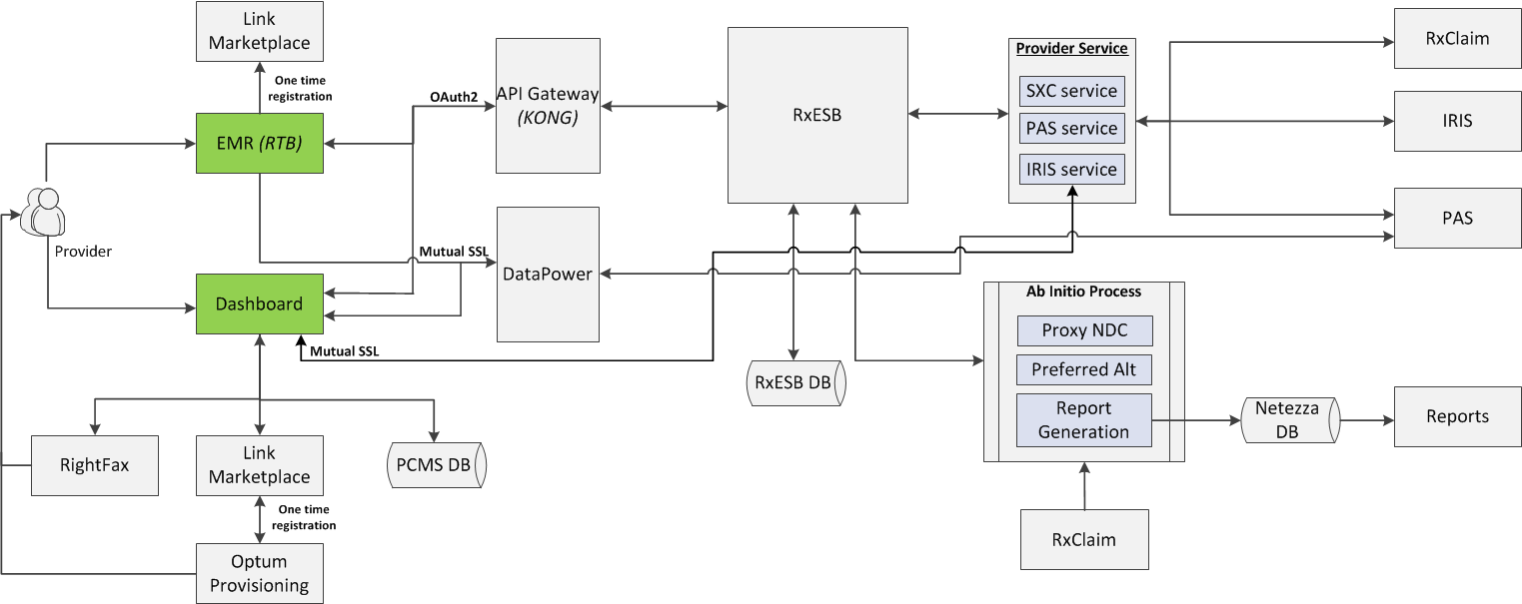
PCMS Architecture Overview - CURRENT
MONITORS
TECH STACK

Slide 51
OptumRx Future State Middleware Layer
Technology Stack Considered
API Gateway
Kong, Tibco, Layer7
Registry, Discovery, Rate-limit, Throttle, Authentication, Authorization
Orchestration, Aggregation, Transformation
RxESB, Tibco, Mulesoft
asynchronous
EDGE Portal API
synchronous
EDGE Portal API
Service Bus
Coarse Grained Process API
Coarse Grained Process API
Java/J2EE, Micro-service model
Message Queue
Fine Grained Micro-Service
Fine Grained Micro-Service
Fine Grained Micro-Service
Logging Framework
Kafka, RabbitMQ
Materialized View - IVR
Materialized View - Mobile
Materialized Views
Materialized Views
Cassandra & Redis
Materialized Views
Materialized Views
Materialized Views
Data Transformation Layer
Consumer
Topic
Topic
Topic
Topic
Topic
Topic
Topic
Topic
Topic
Topic
Topic
Kafka with Ab Initio Rules Engine
Publisher

Slide 52
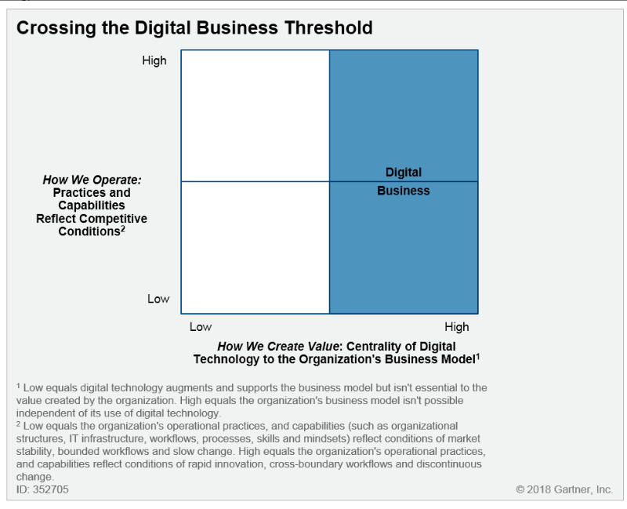
Optum Rx Digital Strategy Definitions
Digital – Use of Technology to
Improve organizational/business processes
Improve interactions between customer and business
Enable new business models
Enable a Polyglot Tech Stack that lets us abandon one-size-fits-all approach and select the best fit for each application
Digital Optimization – Use of technology to
Improve existing operational process/workflow
Improve CRM and customer engagement
Digital sales and marketing
Mobile / Analytics / Chat
Increase efficiency and save costs
Augment existing business with digital capabilities
AI /ML / Reporting
Adopt tools to support new technology use
Digital Business – Offering of Business products / services / models that
Are only made available through technology
Are not digital copies of analogous business services
Only exist as a result of the business adopting specific information management production methods
AI / ML / Analytics
Are directly tied to the business measured value (NPS)
Digital Transformation – Creation of a Digital business by
Exploiting digital technologies and capabilities
Continuously creating new value by adjusting to disruption
Doing new things in new ways
Adopting new organization and operating models
Maintaining low-complexity, highly-scalable systems to enable rapid delivery of new services and means of operating

Slide 53
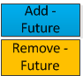
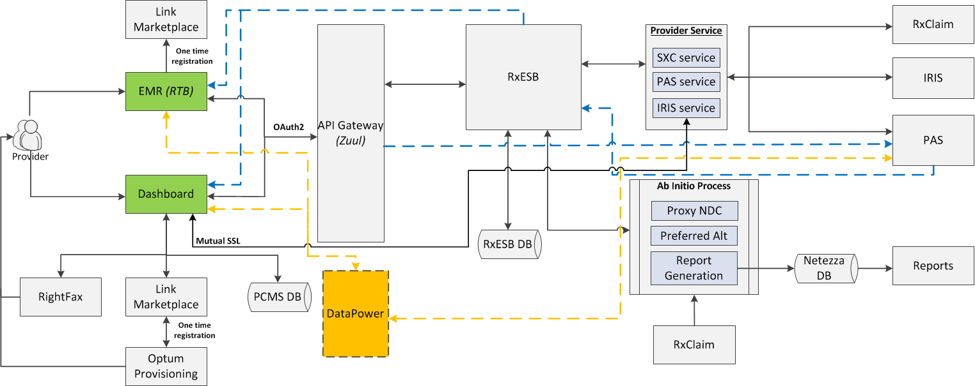
PCMS Architecture Overview - FUTURE
FUTURE INTEGRATIONS
Notes:
Engaging members at point of prescription to increase value - OptumRx clinical alerts, Health and wellness opportunities, Prioritized next best action

Slide 54
PCMS evolution

Slide 55
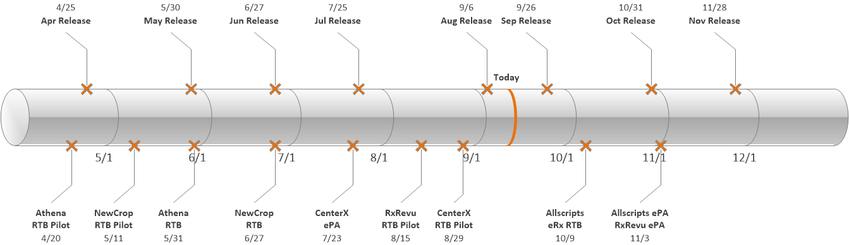
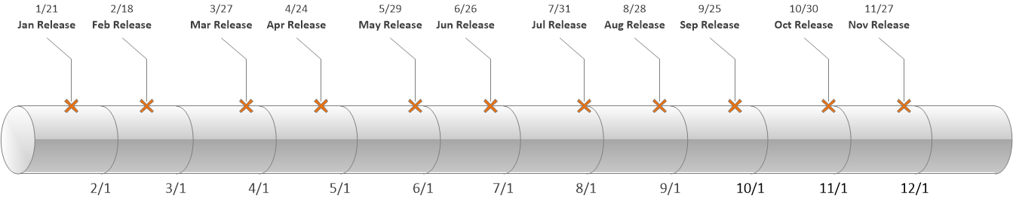
PCMS - Roadmap
Q3-2018 | Q4-2018 | Q1-2019 | Q2-2019
EMR Releases: RxRevu RTB Pilot 8/15 CenterX ePA, 7/23, RTB Pilot 8/29 Jul Release: (7/25) Prescriber Book Updates (D) Local Messages P1b (D) NDC Proxy P4 DAW 0 MSC=O drugs Unbreakable Update P1 LOB Value Reports YTD MVP Aug Release: (8/29) Alt Pharm Mail Order P1b (E) Med D Phase Service Change (D) Design Updates Pref Alts ORxMED Allowance Reporting Metric Expansions (O,C) Sep Release: (9/26) Specialty Prod/Pharm Dt (D) Accessibility Updates (D) Opioid PA Message Update P1 (E) Reporting Metrics Expansions (O,C) Self Service Value Reporting (O,C) Client Reporting Visualizations | EMR Releases: Allscripts eRx RTB 10/9, ePA 11/3 RxRevu ePA 11/3 Oct Release: (10/31) Specialty Prod/Pharm Dt (E) Stored Procedure Creation and Logic updates – Proxy NDC Carrier Exclusion (D) Reporting Metric Expansions Operating Report Visualizations Nov Release: (11/28) Configurable Messaging (B) Opioid PA Message Update P1 (D) A1-PRD/A5-KSR RxCLAIM Connectivity (B) Proactive PA ECS Integration with Proxy NDC Stored Procedure Dashboard Feature Callouts (D) Opioids Notifications P2a/b (B) B4G Logic ePA (D) B4G Logic for Price Check (B) Reporting Metric Expansions Value Report Visualizations | Dec/Jan Release (1/30) F&B Preferred Alts Enhancements (B) BPE Integration P1a – TBD (D) DUR Messaging P1a (E) Display Savings through HD (B) Feb Release (2/27) BPE Integration P1b – TBD (E) Specialty Briova Exclusive Pharmacy P2 (E) DUR Messaging P1b (D) API Gateway Migrations RTB/PAS (E) Mar Release (3/27) BPE Integration P2a - TBD (D) Silent Auth Enhancements (B) Specialty Briova Exclusive Pharmacy P2 (D) API Gateway Migrations RTB/PAS (E) A2-GAM/A2-SDM/A2-NVM/A2-INM/A1-M21 RxCLAIM Connectivity(B) | Apr Release: (4/24) BPE Integration P2b -TBD (E) Unbreakable API (B) Increased # of Alts (B) API Gateway Migrations RTB/PAS (E) May Release: (5/29) Preferred Channels P1a (D) Diagnosis Code Trials (E) ESP/Cash Wrapper Integration (B) API Gateway Migrations RTB/PAS (E) Jun Release: (6/26) Diagnosis Code Trials (D) Local Messaging P3 (B) Preferred Channels P1b (E) API Gateway Migrations RTB/PAS (E) Key: ✓ Completed Committed Tentative (E) - EMR Only (D) - Dashboard Only (B) - Dashboard & EMR (O) - Operating Report (V) - Value Report (C) - Client Report BPE Items – we are still TBD as to which portions of BPE each side of the PCMS application will connect to in Q1, Q2. Detail to come.

Slide 56
Application: PCMS Rx LOB: DSG Rx Owner: SK
Optum Rx Enterprise Roadmap
Completed
Proposed
Agreed Upon
Domain |  | 2018 | 2019 |  |  |  | 2020 |  | 2021
 |  | Q4 Current | Q1 | Q2 | Q3 | Q4 | 1H | 2H
HCP Features |  |  | BPE Integration P1a – TBD API Gateway Migrations RTB/PAS (E) A2-GAM/A2-SDM/A2-NVM/A2-INM/A1-M21 RxCLAIM Connectivity(B) |  | Integration with Zuul API Gateway for ePA service.
App Code Base |  | Java
Web App | VM
 | Cloud | PROD - OSE Stage - OSE Test – OSE Dev – OSE (migration to OSO in POC)
DB Platform |  | MySQL
Integration |  | RxESB IRIS Web Services AE/UPM - PAS Link Provisioning Optum Provisioning
HA/DR |  | OSE GTM HA (ELR/CTC)
Capital Outlook |  | TBD
Native Business Capability
L0: Administer Benefits & Services
L1: Manage Consumer Eligibility & Enrollment
L2 Determine Eligibility
L0: Manage Health Services
L1: Care Delivery
L2 Medication Prescription
L1: Health Decision Support
L2 Treatment Selection
L3 Treatment Options Determination
L1: Utilization Management
L2 Clinical Coverage Review
L3 Coverage Determination
System Dependencies
L1: Utilization Management
RxESB, PAS, RxClaim, IRIS
L1: Inventory, Orders, Logistics & Fulfillment
RxESB, IRIS
L1: Manage Claims
RxESB, RxClaim, PAS
L1: Care Delivery
EMR, Ab Initio
L1: Manage Consumer Eligibility & Enrollment
EMR, RxClaim, IRIS,
L1: Manage Claims
Surescripts
Application / Platform TCO
2018: $302K
2019:
2020:
Notes: As of Aug 2018:
$5K (Infrastructure)
$297K (O&M)

Slide 57
Client Portal future

Slide 58
Client Portal evolution

Slide 59
Application: Client Portal Rx LOB: DSG Rx Owner: SK
Optum Rx Enterprise Roadmap
Completed
Proposed
Agreed Upon
Domain |  | 2018 | 2019 |  |  |  | 2020 |  | 2021
 |  | Q4 Current | Q1 | Q2 | Q3 | Q4 | 1H | 2H
HCP Features
App Code Base |  | Java IBM Portlet SDK
Web App | VM | Prod Authoring Stage Test Dev | Migration to MN DC
 | Cloud
DB Platform |  | Oracle
Integration |  | SXC WebServices AD – sxc.app/sxc.com OID CBS |  | MSID OID
HA/DR |  | Current – N/A |  | Active/Standby (RTO 24, RPO 1)
Capital Outlook |  | TBD
Native Business Capability
L0: Manage Demand
L1: Manage Sales
L2 Manage Client Relationship
L1: Perform Marketing
L2 Develop 7& Execute Campaigns
L0: Manage Operations
L1: Contact Operations
L2 Issue Management
System Dependencies
L1: Data Operations
SXC Web Service
L1: Information Technology Enabling Services
Optum ID
L1: Perform Marketing
AEM
L1: Manage Billing & Collections
CBS
Application / Platform TCO
2018: $563K
2019:
2020:
Notes: As of Aug 2018:
282k (Infrastructure)
281k (O&M) – Numbers include figures for “Client Portal (OptumRx)” and “ORx Client Information Center” records
$13K Client Portal (OptumRx)
$268K ORx - Client Information Center

Slide 60
Future RxProvider Portal

Slide 61
Evolution RxProvider Portal

Slide 62
Application: RxProvider Portal Rx LOB: DSG Rx Owner: SK
Optum Rx Enterprise Roadmap
Completed
Proposed
Agreed Upon
Domain |  | 2018 | 2019 |  |  |  | 2020 |  | 2021
 |  | Q4 Current | Q1 | Q2 | Q3 | Q4 | 1H | 2H
HCP Features
App Code Base |  | Java AEM |  |  |  |  |  | Open Source CMS
Web App | VM | Prod Stage Test Dev |  | Dev – OSO | Test - OSO | Stage and Prod - OSO
 | Cloud
DB Platform |  | iSeries
Integration |  | WebCommon RxClaim
HA/DR |  | Active/Standby (RTO 8, RPO 0)
Capital Outlook |  | TBD
Native Business Capability
L0: Administer Benefits & Services
L1: Manage Consumer Eligibility & Enrollment
L2 Determine Eligibility
L1: Implement Customer Benefits & Svcs
L2 Manage Drug Pricing & Reference Data
L3 Manage & Maintain MAC Pricing
L0: Manage Operations
L1: Contact Operations
L2 Service Operations
L3 Claim Status
L1: Inventory, Orders, Logistics & Fulfillment
L2 Orders
L3 Intake Order Payment
L0: Manage Health Services
L1: Health Decision Support
L2 Health Education
L2 Clinical Coverage Review
L3 Coverage Determination
L0: Manage Providers
L1: Provider Relationship Management
L2 Provider Communication & Training
analogous
analogous
System Dependencies
L1: Manage Claims
RxClaim
L1: Constituent Service Experience Strategy
Adobe Experience Manager
Application / Platform TCO
2018: $246K – see notes
2019:
2020:
Notes: As of Aug 2018:
$9K (Infrastructure) - Charges available only for month of August.
Per Rachelle Gonthier charges for this application were undefined for the longest time until now. Only after speaking to the Java team it was reallocated and correct amounts should be showing starting going forward. Cannot generalize 8.9k to be a standard charge going forward as consumption volumes can change.
$237K (O&M)

Slide 63
Appendix

Slide 64
Rx Enterprise Architecture Control Points Why we use these 4 control points to express our strategy
Experience / Business Capabilities
Enables our ability to create a robust and consistent customer journey
Bridges LOBs by providing a Consistent UI/UX across channels / business
How we align HCP services across Optum from a business platform view
Drives the Optum Digital First Customer Experience
Empowers our customer via Personalization/ Self Service
Provides Customer Journey Awareness / Tracking /Reporting
Data – ML /AI
Data is our differentiator – need to unlock it!
Drives data integrity and governance
Core to our customer and product strategy
Makes our products whole – connected and relevant
Bring Optum’s historical data to life through ML/AI
Enriches the Customer Experience via
Enriching data via ML / AI
Surface Data to Digital Surfaces (Client/Member TouchPoints)
Enabling the joined up consumer experience by externalizing data for use by wider business services
Integration
Creates common services framework and technology which drives stability
Drives centralized business rules management
Enables real-time business agility
Generates data velocity across the ecosystem to promote the real-time user experience
Creates a seamless end to end service model
Generates agility /speed to market for both new services as well as augment existing services with enriched data streams
Platform –SW Architecture & Technology
Driving stability through horizontal real time scaling across distributed and discrete environments
Critical success factor in customer satisfaction in terms of
Availability / Stability
Performance
Enables higher service quality and consistency of products
Abstracts our legacy complexity through platform design
Bottom line in operating our business in a manner that allow us to both meet our customer needs as well as optimize operational costs

Slide 65
Optum Rx Enterprise Architecture Strategy Focus
Experience / Business Capabilities
Develop and Integrate Optum HCP Feature set
Digital First – Customer Experience via Technology Enablement
Engineering in Quality & Resilience – Dependent System Awareness & Tolerance
Consistent UI/UX across channels / business
Personalization/ Self Service
Customer Journey Awareness / Tracking /Reporting
Self Sustaining - De-couple from backend systems
Data – ML /AI
Enrich the Customer Experience via
Enriching data via ML / AI
Surface Data to Digital Surfaces (Client/Member TouchPoints)
Converge on foundational data sources (Provider /Eligibility)
Publish Data updates to foundational sources
Externalize Data for use by wider business services
Source insulation on the middleware layer powered with materialized views for high performance and resiliency and real-time data streaming from backend systems
Integration
Micro Service Architecture with cloud enabled deployment model
Edge API use (Tailored for Channel)
Common Course Grain – (Reuse)
Data Service – Tuned with Cache
Common Enterprise Services
Converge onto single Integration Platform
High Reuse / Consistent data and services
API Gateway Access Points
Security
Monitoring
Service Segmentation / Isolation
Platform –SW Architecture & Technology
High Performance - Top to bottom (Application layer through to the Data Access services)
High Availability – Active / Active Topology
DR Capable – RTO/RPO targets
Cloud based platform services
Auto Provisioning & Scaling
Instrumented to support the operational model and targets
Capacity management to optimize allocation and costs
Compliant with Rx PADU to enable standards convergence

Slide 66
Optum Rx Digital- Integration Middleware Strategy
Experience / Business Capabilities
Cloud-native architectures – build small, reusable, autonomous components aligned to business functions / Micro Service API
Containerization and Cloud Enablement
API Governance to promote reusability and standardization of API design
Integration with IOT and voice enabled devices
Centralized security and API Externalization using API Gateway
Productize and Monetize of APIs based on client needs (Cash Card, Workers Compensation and Accumulator Exchange)
Design for the Optum HCP Enterprise
Defensive Coding – Circuit Breakers and Contingency Patterns
Engineered Customer Journey Awareness / Tracking /Reporting
Data – ML /AI
Converge on foundational data sources (Provider /Eligibility)
Publish Data updates to foundational sources
Expose ML models using APIs (Ex: Predictive Prior Authorization Model)
Enrich the Customer Experience via
Enriching data via ML / AI
Surface Data to Digital Surfaces (Client/Member TouchPoints)
Built in Quality and Consistency
Externalize Data for use by wider business services (HCP)
Source insulation on the middleware layer powered with materialized views for high performance and resiliency and real-time data streaming from backend systems
Integration
Micro Service Architecture with cloud enabled deployment model
Edge API use (Tailored for Channel)
Common Course Grain – (Reuse)
Data Service – Tuned with Cache
Common Enterprise Services
Converge onto single Integration Platform
High Reuse / Consistent data and services
Single technology
API Gateway Access Points
Security / Monitoring
Service Segmentation / Isolation
End to end transaction monitoring
Platform –SW Architecture & Technology
High Performance – High Speed Data Velocity & Access
High Availability – Active / Active Topology
DR Capable – RTO/RPO targets
Cloud based – Auto Provisioning & Scaling
Instrumented to optimize performance and tuning
Capacity management – service isolation to promote scaling agility

Slide 67
Optum Rx Digital- Portal Strategy
Experience / Business Capabilities
Digital First – Customer Experience via Technology Enablement
Cloud-native architectures – build small, reusable, autonomous components aligned to business functions
Couple Integration into application framework / Microservice API
Develop and Integrate Optum HCP Feature set
Defensive Coding – Dependent System Awareness & Tolerance
Consistent UI/UX across channels / business
Enable Personalization/ Self Service
Built in Customer Journey Awareness / Tracking /Reporting
Self Sustaining - De-couple from backend systems
Data – ML /AI
Converge on foundational data sources (Provider /Elig)
Publish Data updates to foundational sources
Enrich the Customer Experience via
Enriching data via ML / AI
Surface Data to Digital Surfaces (Client/Member TouchPoints)
Externalize Data for use by wider business services
Source insulation on the middleware layer powered with materialized views for high performance and resiliency and real-time data streaming from backend systems
Integration
Micro Service Architecture with cloud enabled deployment model
Edge API use (Tailored for Channel)
Common Course Grain – (Reuse)
Data Service – Tuned with Cache
Common Enterprise Services
Converge onto single Integration Platform
High Reuse / Consistent data and services
Single technology ?
API Gateway Access Points
Security / Monitoring
Service Segmentation / Isolation
Platform –SW Architecture & Technology
High Performance - Top to bottom (Application layer through to the Data Access services)
High Availability – Active / Active Topology
DR Capable – RTO/RPO targets
Cloud based –Auto Provisioning & Scaling
Instrumented to optimize operations, support and tuning
Capacity management to right size for demand

Slide 68
Optum Rx Digital- Mobile Strategy
Experience / Business Capabilities
Digital First – Customer Experience via Technology Enablement
Cloud-native architectures – build small, reusable autonomous components aligned to business functions / Microservice API
Develop and Integrate Optum HCP Feature set
Defensive Coding – Dependent System Awareness & Tolerance
Consistent UI/UX across Mobile channels / business
Personalization/ Self Service
Built in Customer Journey Awareness / Tracking /Reporting
Self Sustaining - De-couple from backend systems
Data – ML /AI
Converge on foundational data sources (Provider /Elig)
Publish Data updates to foundational sources
Enrich the Customer Experience via
Enriching data via ML / AI
Surface Data to Digital Surfaces (Client/Member TouchPoints)
Externalize Data for use by wider business services
Source insulation on the middleware layer powered with materialized views for high performance and resiliency and real-time data streaming from backend systems
Integration
Micro Service Architecture with cloud enabled deployment model
Edge API use (Tailored for Channel)
Common Course Grain – (Reuse)
Data Service – Tuned with Cache
Common Enterprise Services
Converge onto single Integration Platform
High Reuse / Consistent data and services
Single technology ?
API Gateway Access Points
Security / Monitoring
Service Segmentation / Isolation
Platform –SW Architecture & Technology
Transform to native UI development aligning with iOS and AOS
Leverage Optum Mobile COE recommended standards and tools
High Performance / Application through to Data Access layer
Highly Available – Active / Active Topology
DR Capable – RTO/RPO targets
Cloud based –Auto Provisioning & Scaling
Instrumented to optimize operations, support and tuning
Capacity management – right sized to meet demand

Slide 69




Platform - Future
Consuming
Applications
Internal
Commercial
Products
Consumer Applications
Clinical and Rx Applications
Provider Applications
Optum Health
Portals
Mobile
Navigator / IVR
IRIS
RxClaim
PAS /ePAS
PCMS
Rx Technology Platform
Integration
& Data
Optum Rx Enterprise Service Bus
API Streaming
Data
Optum Rx Enterprise Data Services
API Streaming
Platform
Auto Provision
Auto Scaling
Instrumentation
Security Framework
Containerization
Platform Utilities
Web/Pres
IIS
Web srvr
Capacity Mngt
IIS
web
Web/Pres
CI/CD
Production Services
Authentication
App
jBOSS
App server
Reporting
jBOSS
Pharmacy
App
Environment Mgt
DB
Oracle
SQL
Cassandra
Performance Test
DB2
Oracle
DB
Certs Mgmnt
Public / Private Cloud
Dedicated / Virtual Hosting
OSFI
Azure
AWS
ELR
CTC

Slide 70
Platform - Current
Consuming
Applications
Internal
Commercial
Products
Consumer Applications
Clinical and Rx Applications
Provider Applications
Optum Health
Rx Technology Platform
Portals
Mobile
Navigator / IVR
IRIS
RxClaim
PAS /ePAS
PCMS
Integration
Optum Rx Enterprise Service Bus
API Streaming
Data
Optum Rx Enterprise Data Services
API Streaming
Platform
Auto Provision
Auto Scaling
Instrumentation
Security Framework
Containerization
Platform Utilities
Web/Pres
IIS
Web srvr
Wb serv
Capacity Mngt
IIS
Pharmacy
Web/Pres
CI/CD
Product Services
Authentication
App
jBOSS
App srver
Reporting
jBOSS
Pharmacy
App
Environment Mgt
DB
Oracle
SQL
Cassandra
Performance Test
DB2
Oracle
DB
Certs Mgmnt
Public / Private Cloud
Dedicated / Virtual Hosting
OSFI
Azure
AWS
ELR
CTC

Slide 71
Optum Rx Data Services – Blueprint
Rx Data Platform
Consuming
Applications
Internal
Commercial
Products
Consumer Applications
Clinical and Rx Applications
Provider Applications
Optum /UHC
Portals
Mobile
Navigator / IVR
IRIS
RxClaim
PAS /ePAS
PCMS
Integration
Optum Rx Enterprise Service Bus
Data
API Streaming
Data Governance
Data Stewardship
Meta Data Management
Data Security
Data Quality
Data Services
Data Utilities / Functions
Data Services
Reporting
Analytics
Fraud Detection
Claims
Consumer
Benefit
Plans
Provider
Pharmacy
Behavioral
Waste Detection
Abuse Detection
Genomics
Clinical
Eligibility
CRM/Call
Financial
Lab
EMR
ML/AI Workbench
Data Syndication Tool
Data Capture Tools
Enterprise API Streaming
Optum Rx Local Data Stores (Direct & Streaming)
Medical/Rx
Claims
Data Lake
Clinical
Provider
Eligibility
PAS
IRIS
RxClaim
NAV
Other

Slide 72
Current State - Optum Rx Data Services
Rx Data Platform
Consuming
Applications
Internal
Commercial
Products
Consumer Applications
Clinical and Rx Applications
Provider Applications
Optum Health
Portals
Mobile
Navigator / IVR
IRIS
RxClaim
PAS /ePAS
PCMS
Integration
Optum Rx Enterprise Service Bus
Data
API Streaming
Data Governance
Data Stewardship
Meta Data Management
Data Security
Data Quality
Data Services
Data Utilities / Functions
Data Services
Reporting
Analytics
Fraud Detection
Claims
Consumer
Benefit
Plans
Provider
Pharmacy
Behavioral
Waste Detection
Abuse Detection
Genomics
Clinical
Eligibility
CRM/Call
Financial
Lab
EMR
ML/AI Workbench
Data Syndication Tool
Data Capture Tools
Enterprise API Streaming
Optum Rx Local Data Stores (Direct & Streaming)
Data Lake
Provider
PAS
IRIS
RxClaim
NAV
Other

